Slide 1
WELCOME
PAKO ENGINEERS
MANUFACTURE & EXPORTER OF
PRECISION MACHINED COMPONENTS & PUMP ASSEMBLIES

Slide 2
INTRDUCTION
NAME OF THE COMPANY : PAKO ENGINEERS.
YEAR OF ESTABLISHMENT : 1994
CERTIFIED ISO 9001 :2015
KEY PERSON :
MR. SUDARSHAN KHOT (CEO) +91- 9921854252
MR. SUHAS KHOT (M.D) +91- 9860269972
ACTIVITIES :
Manufactures & Exports Shafts , Sleeves , Coupling , ump parts & accessories in all material of construction.
MAN POWER :
Engineers=2
Officers = 2
Technical Supervisors = 3
Quality Control = 2
Programmer = 2
Skilled Labour = 14
Semi Skilled Labour = 10
Helping staff = 12
Total Strength = 47

Slide 3
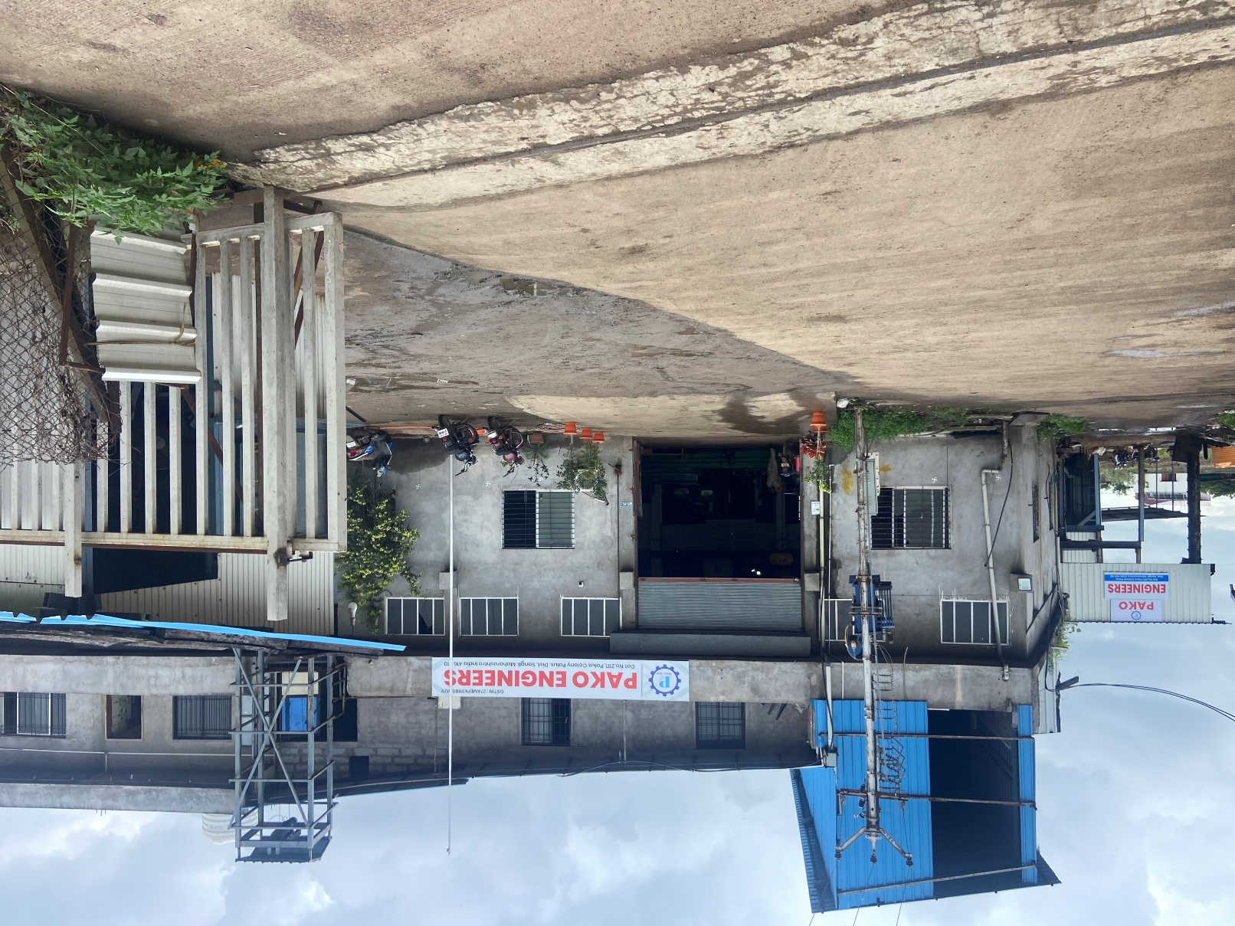
PAKO ENGINEERS

Slide 4
ORGANIZATIONAL STRUCTURE
CEO
Mr. SUDARSHAN KHOT
MD
Mr. SUHAS KHOT
PRODUCTION
QUALITY
Mr. TEJAS SURVE Mr. SUHAS KHOT
ACCOUNT
Mr. DIPAK BOBADE
IN HOUSE
Mr. YOGESH MANGAVE
OUT SOURCE
Mr. AMIT PAWAR

Slide 5
TEST FACILITIES (IN HOUSE / OUTSIDE)
INHOUSE:-
HARDNESS TESTING
SURFACE CHECK
NDT (D.P.T)
OUTSOURCE:-
ULTRASONIC TESTING
METALLURGICAL TEST PHYSICAL AND CHEMICAL
HEAT TREATMENT
NDT (RADIOGRAPHY)
PMI
The Production Department Has All The Necessary Measuring Instruments As Calipers, Micrometers And Gauges.

Slide 6
PRODUCT DETAIL
PRODUCT | MATERIAL | SIZE | FINISH
SHAFT | Stainless steel , Duplex , Super Duplex , Nitronic 50 | Diameter = 50 mm To 1500 mm Length = 0.5 To 14 mtr | 10 To 50microns.
SLEEVES | Stainless steel , Duplex , Super Duplex , Nitronic 50 | Diameter = 50 mm To 400 mm Length = 0.1 To 1 mtr | 10 To 50 microns.
COUPLINGS | Stainless steel , Duplex , Super Duplex , Nitronic 50 | Diameter = 50 mm To 400 mm Length = 0.1 To 1 mtr | 10 To 50 microns.
PUMP PARTS & ACCESSORIES | Stainless steel , Duplex , Super Duplex , Nitronic 50 | Customize | 10 To 50 microns.

Slide 7
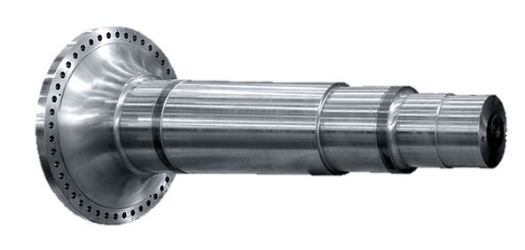
Flange / Concrete shaft
Capacity-
Machining-50mm to 1500 mm in diameter up to 14000 mm length
Grinding – 50 mm to 800 mm diameter up to 6500 mm length

Slide 8
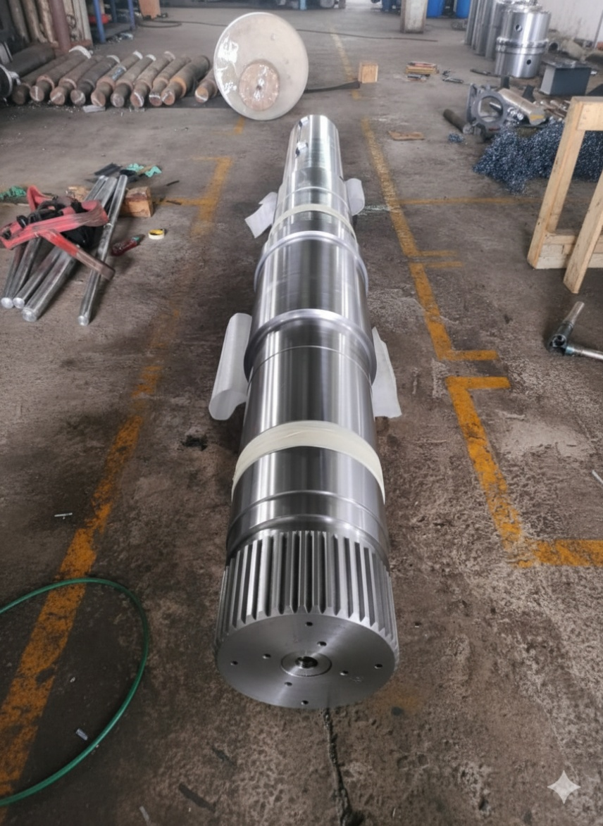
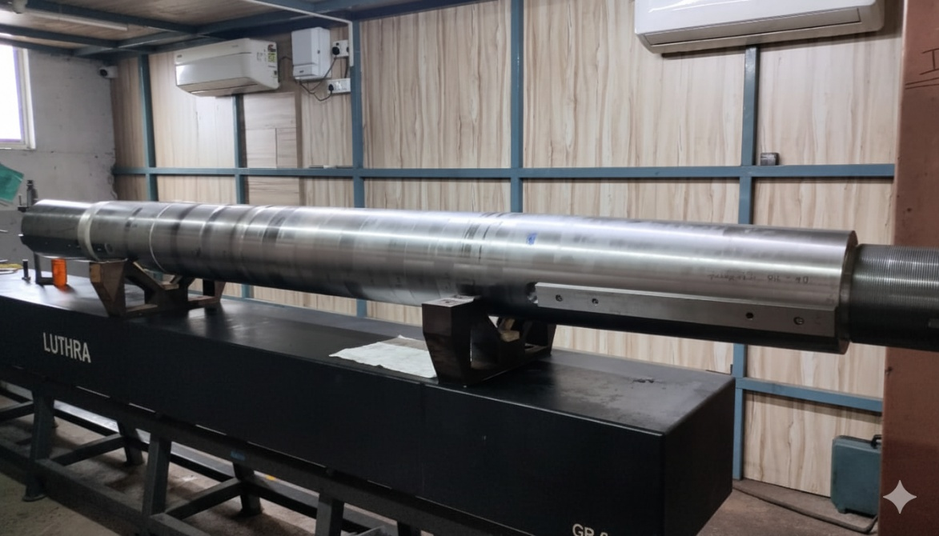
Shaft
Capacity-
Machining-50 mm to 1500 mm in diameter up to 8000 mm length
Grinding – 50 mm to 800 mm diameter up to 6500 mm length

Slide 9
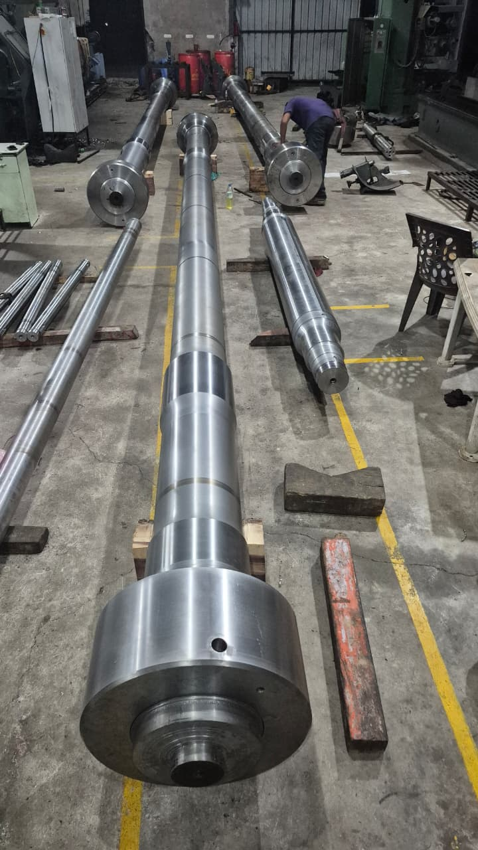
SPECIAL SHAFTS
SHAFT DIMENSIONS
DIAMETER:- 400MM
LENGTH:- 9500MM
THREAD LENGTH:- 390MM

Slide 10
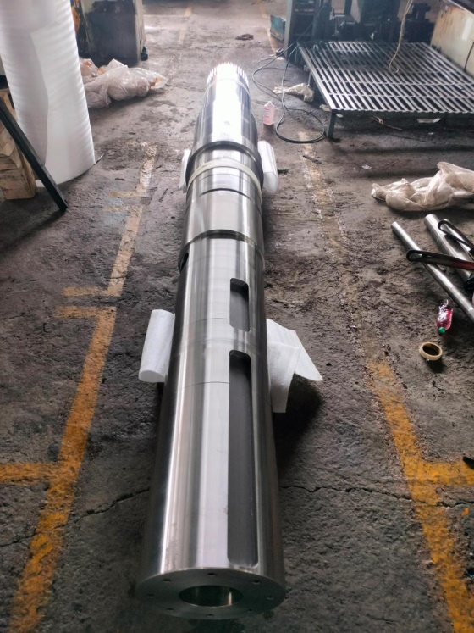
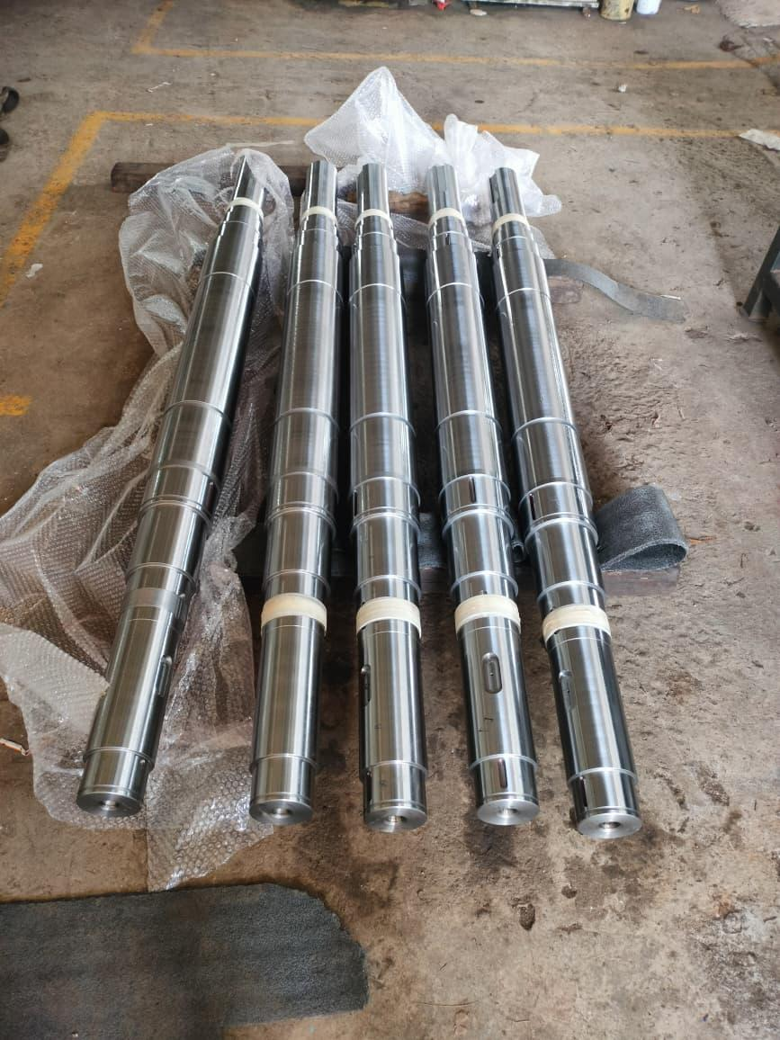
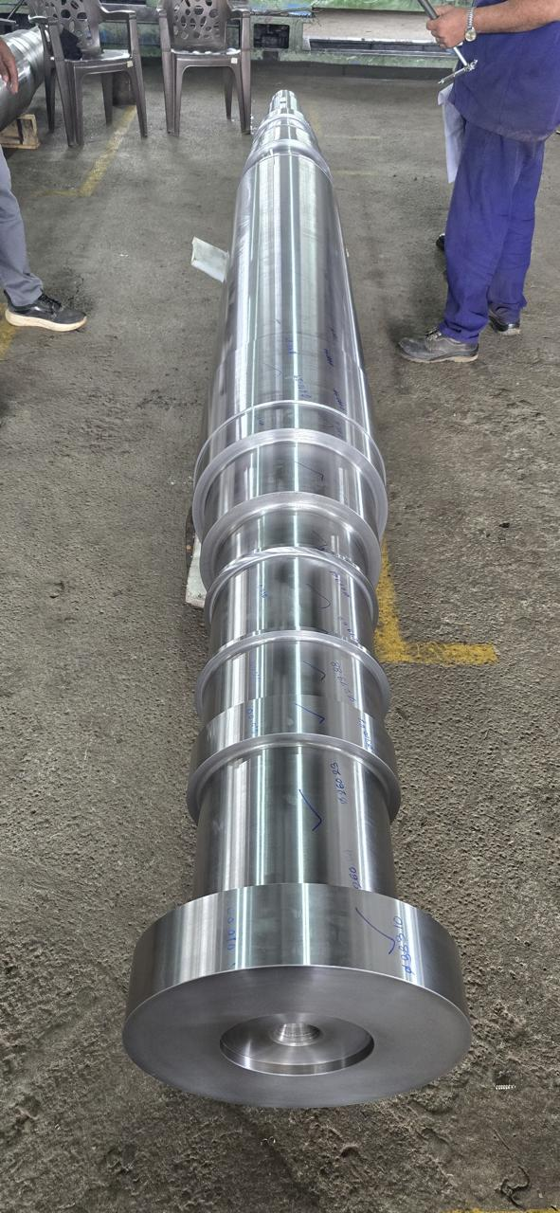
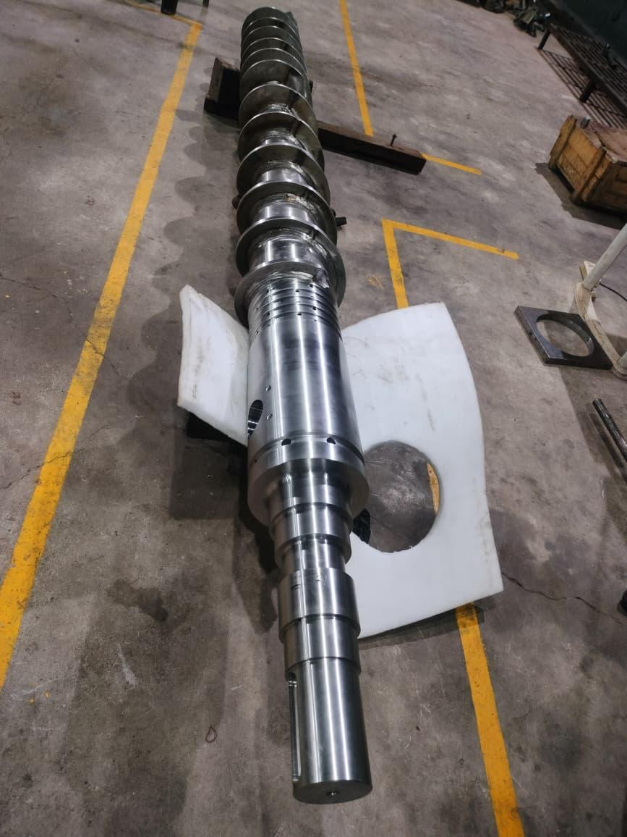
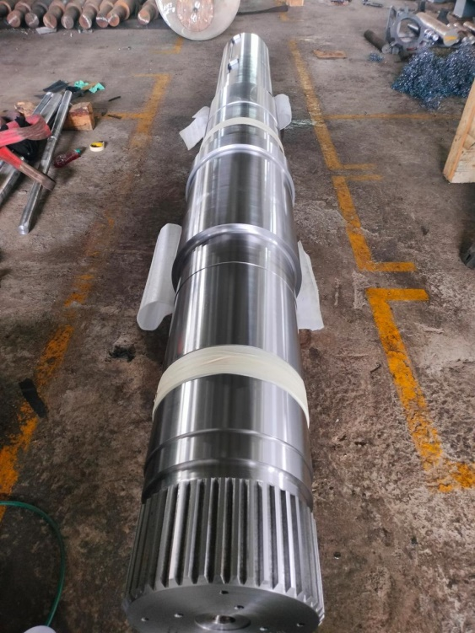
SHAFTS PHOTOGRAPH

Slide 11
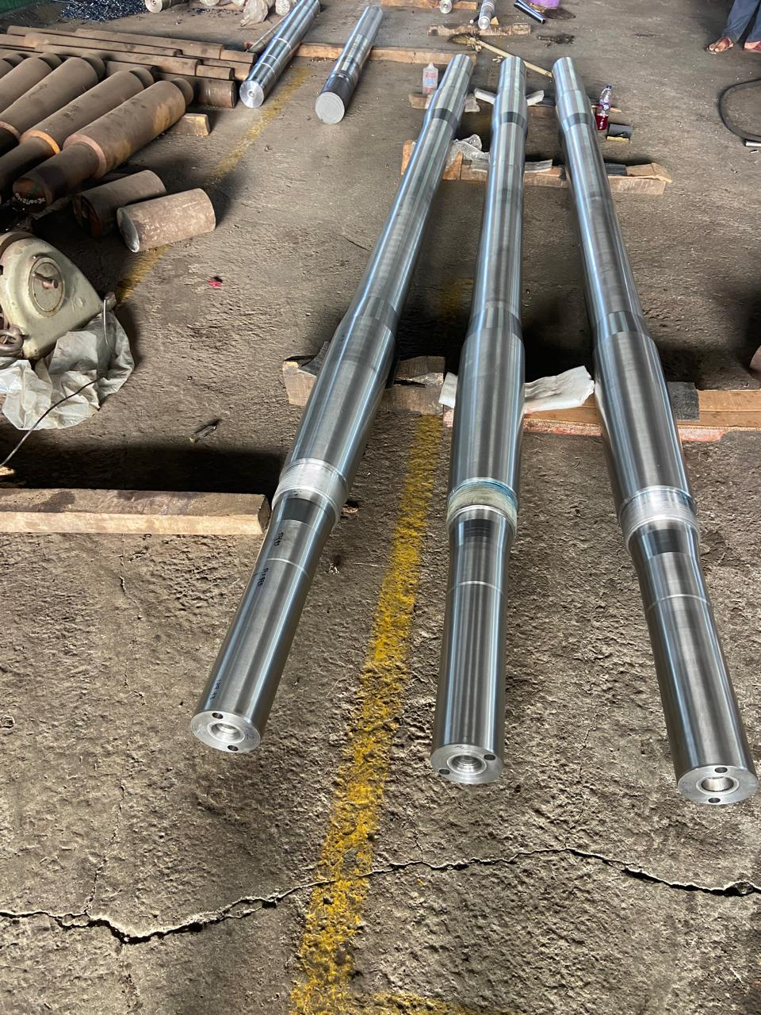
SPECIAL GRADE MATERIAL
DIAMETER:- 200MM
LENGTH:- 4882MM
MATERIAL:- X2CrNiMoN 22 5 3

Slide 12
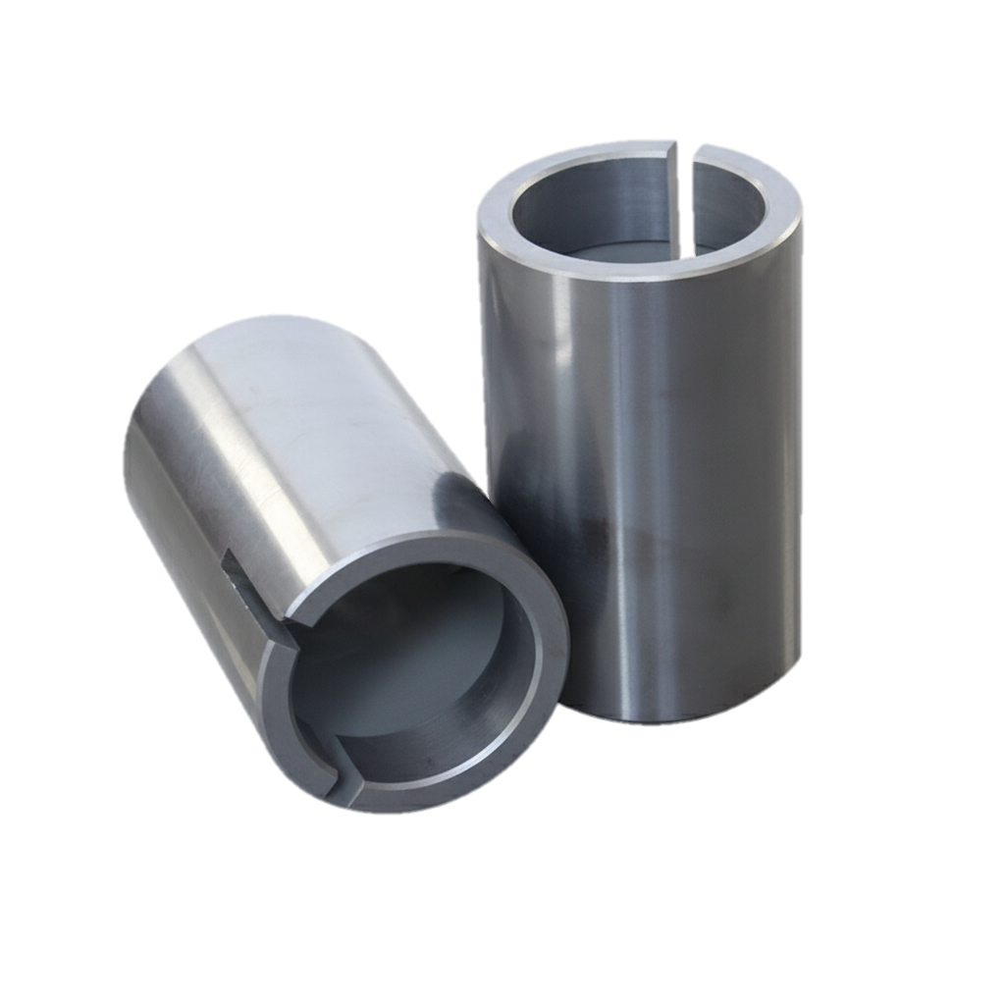
Sleeve /Muff Coupling/Bushes
Capacity -
Machining-50 mm to 1500 mm in diameter
Grinding-50 mm to 500 mm (internal diameter) up to 1000 mm length
50 mm to 800 mm (outer diameter) up to 1000 mm length
Internal Key Way -1200 mm

Slide 13
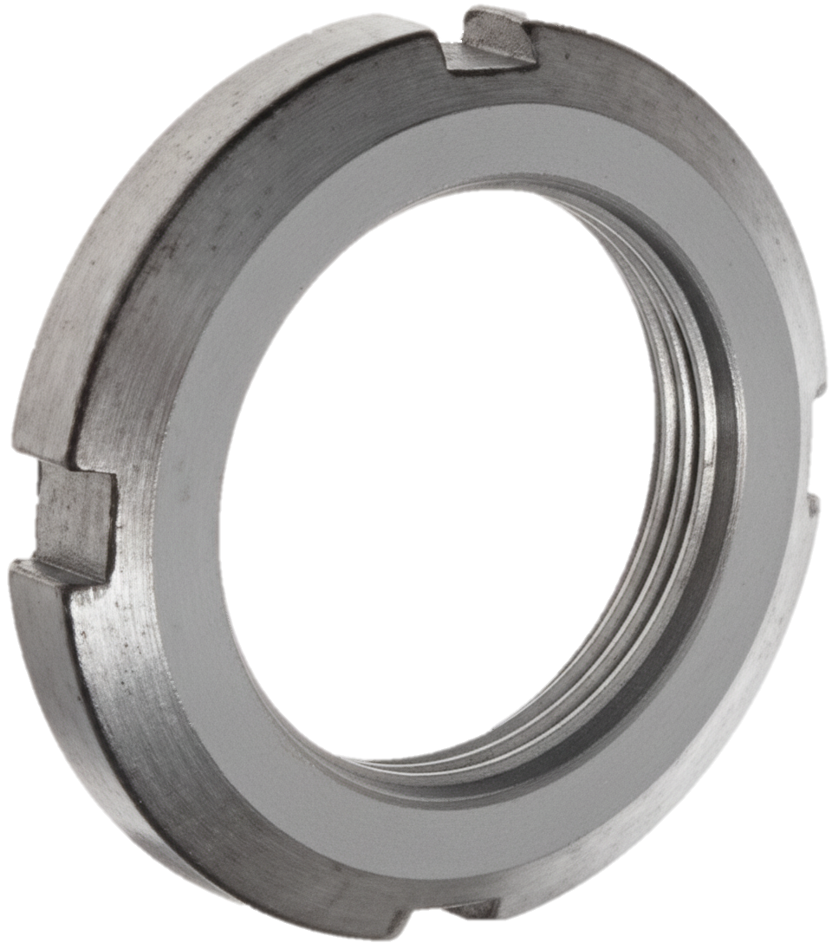
Lock Nut
Capacity-
machining-30 mm to 750mm in diameter
Threading -1 mm to 120 mm pitch (metric)

Slide 14
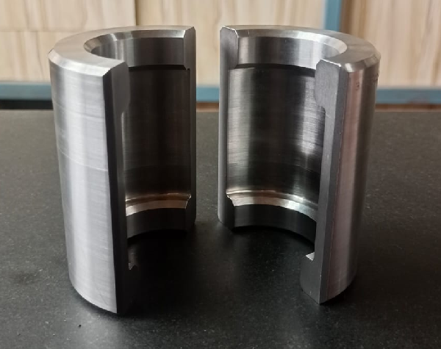
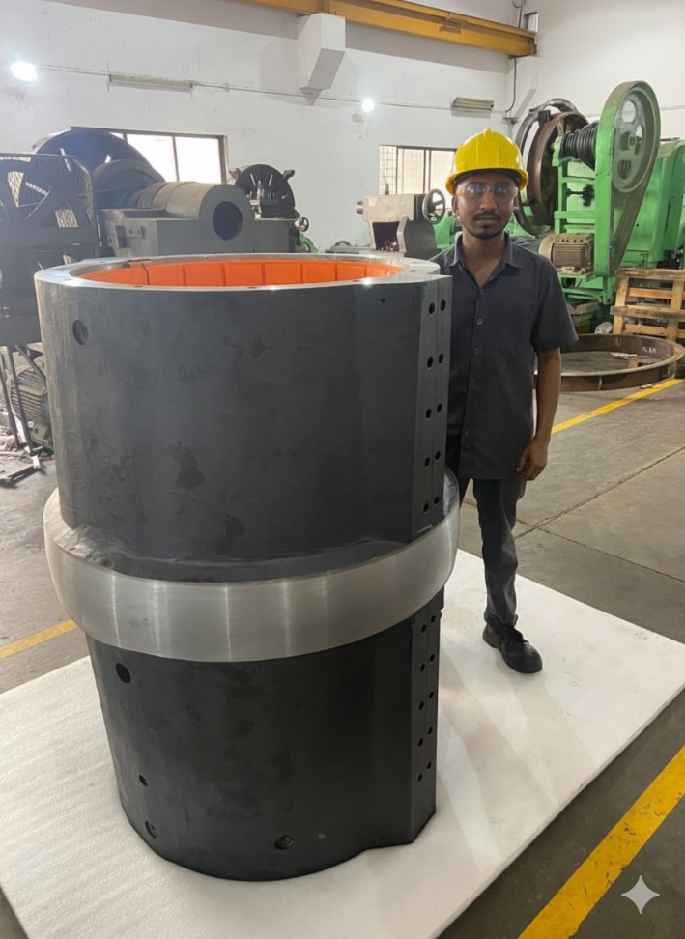
Retainer Ring / Thordon Bearing
Capacity-
Machining- 70 mm to 700 mm in diameter

Slide 15
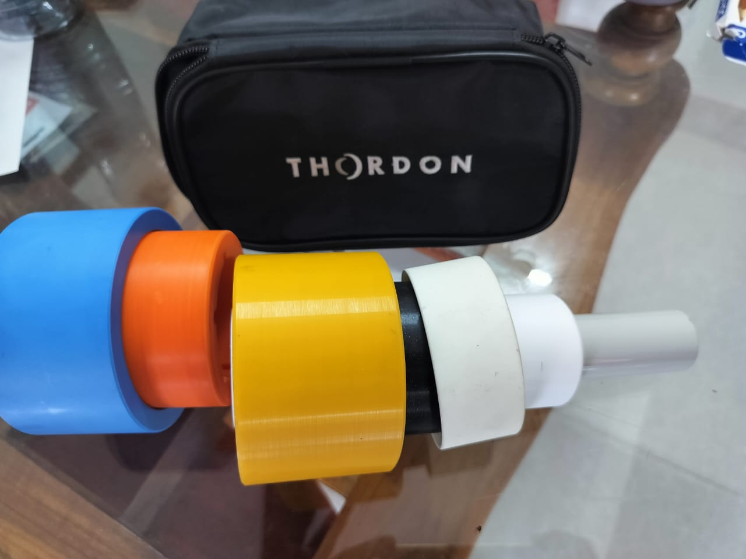
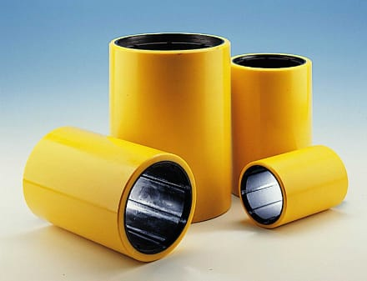
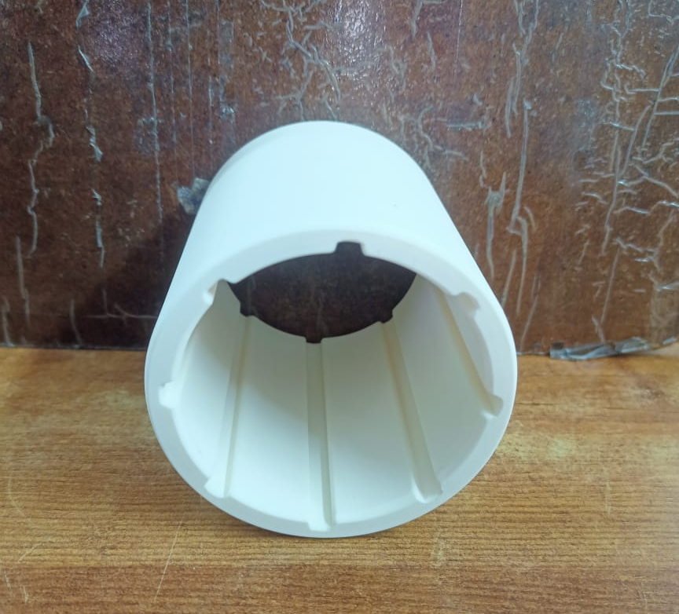
Thordon Bearing

Slide 16
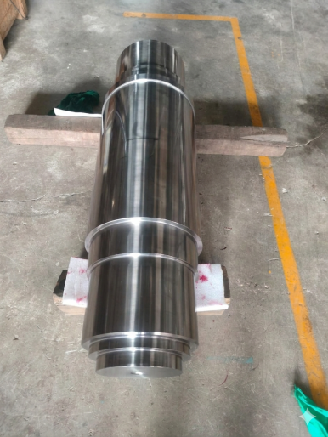
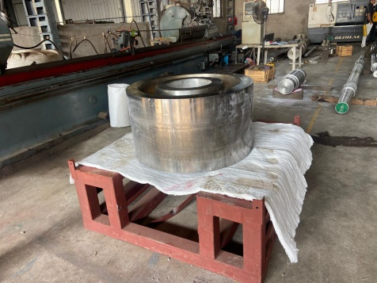
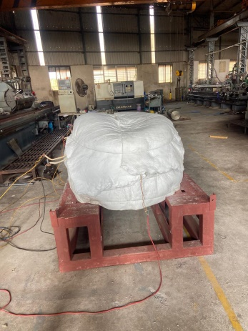
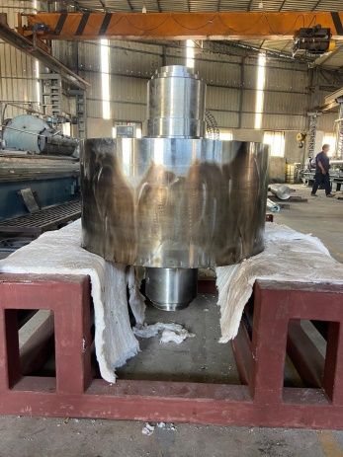
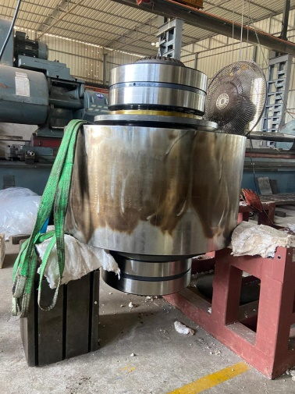
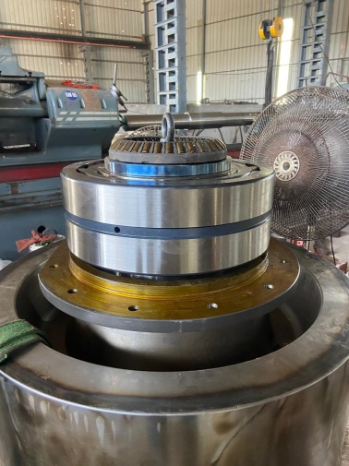
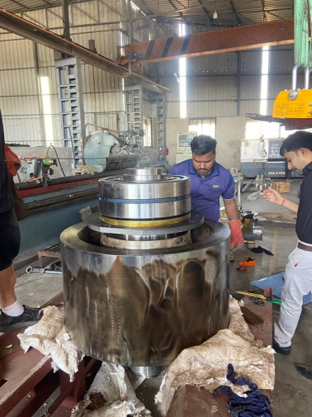
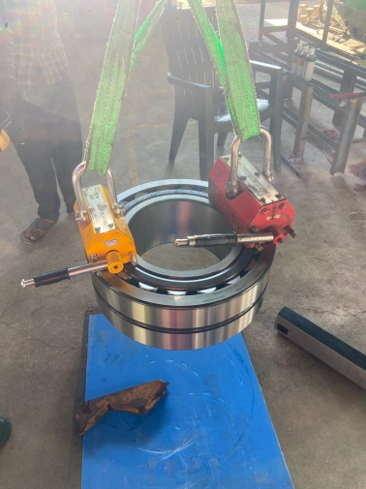
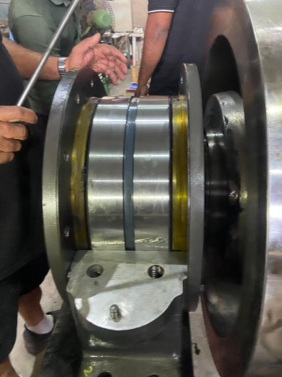
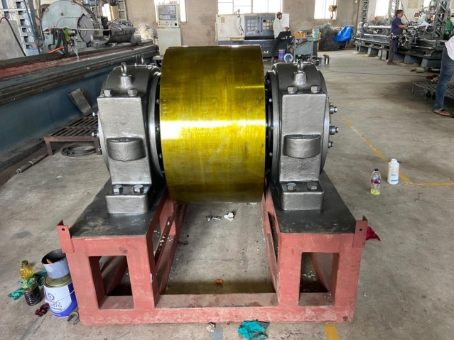
ASSEMBLY DONE IN HOUSE

Slide 17

COMPLETE ASSEMBLY PICTURE
PROJECT NAME :- ES-562

Slide 18
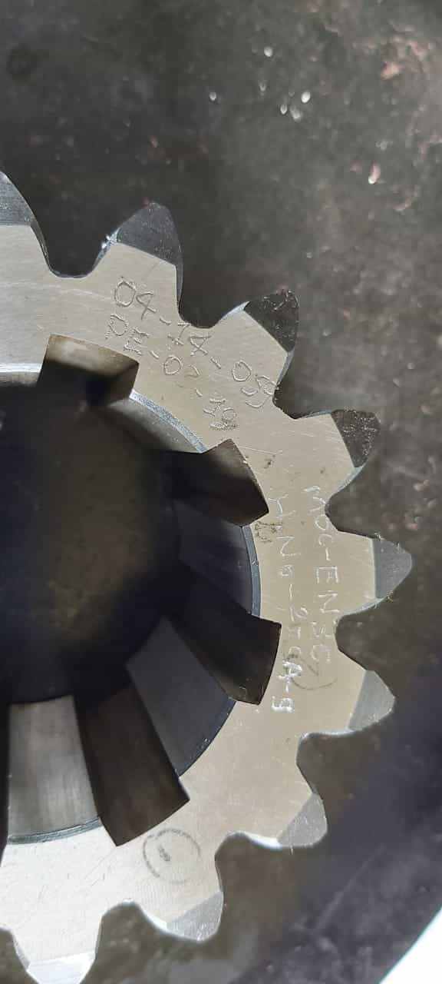
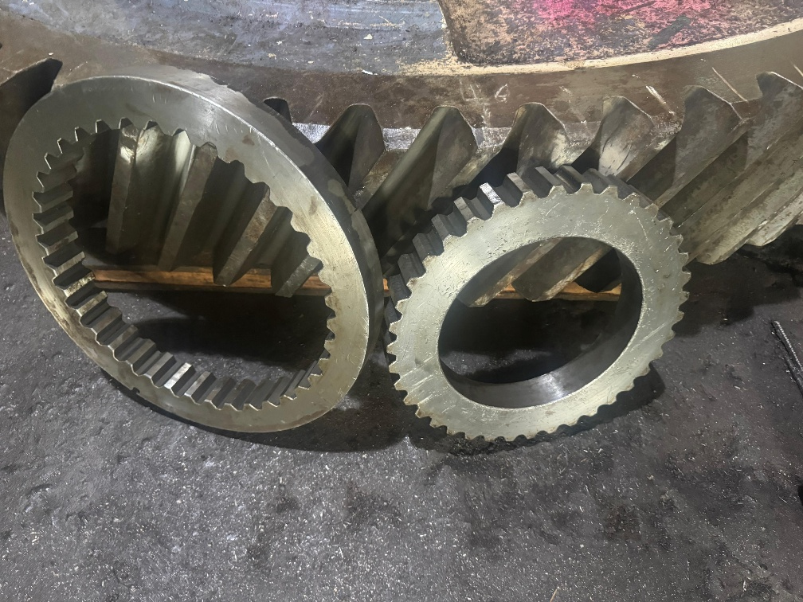
Gears
As per customer requirement all types of gears of moderated ranges are manufactured by us .

Slide 19
Material Grades
ALL GRADE OF SS (STANELESS STEAL)
ALL GRADES OF DUPLEX & SUPER DUPLEX
ALL GRADE OF EN SERISE
SPECIAL MATERIAL GRADES LIKE
K MONEL 400 & 500
FOR BUSHES
GUM METAL, FEROFORM F363, NEOPRENE RUBBER, RG12, THORDON

Slide 20
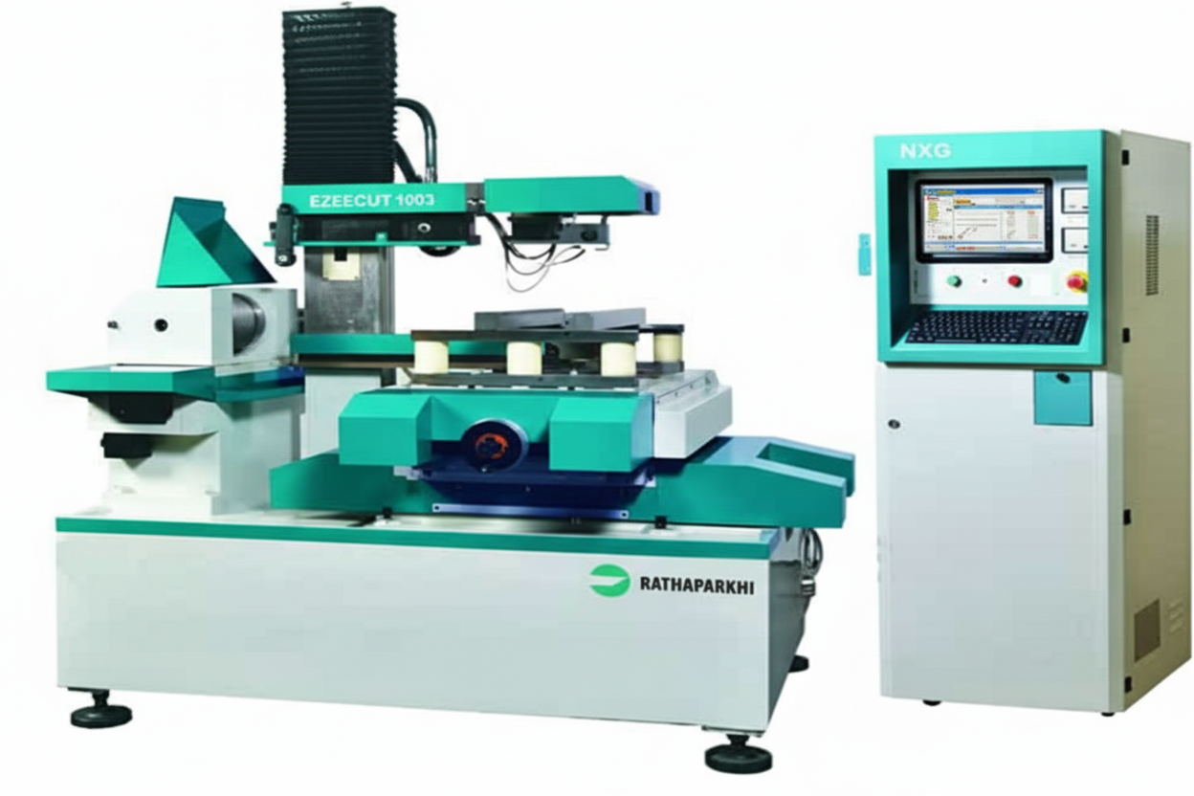
NXG EZEECUT Wire Cut Machine

Slide 21
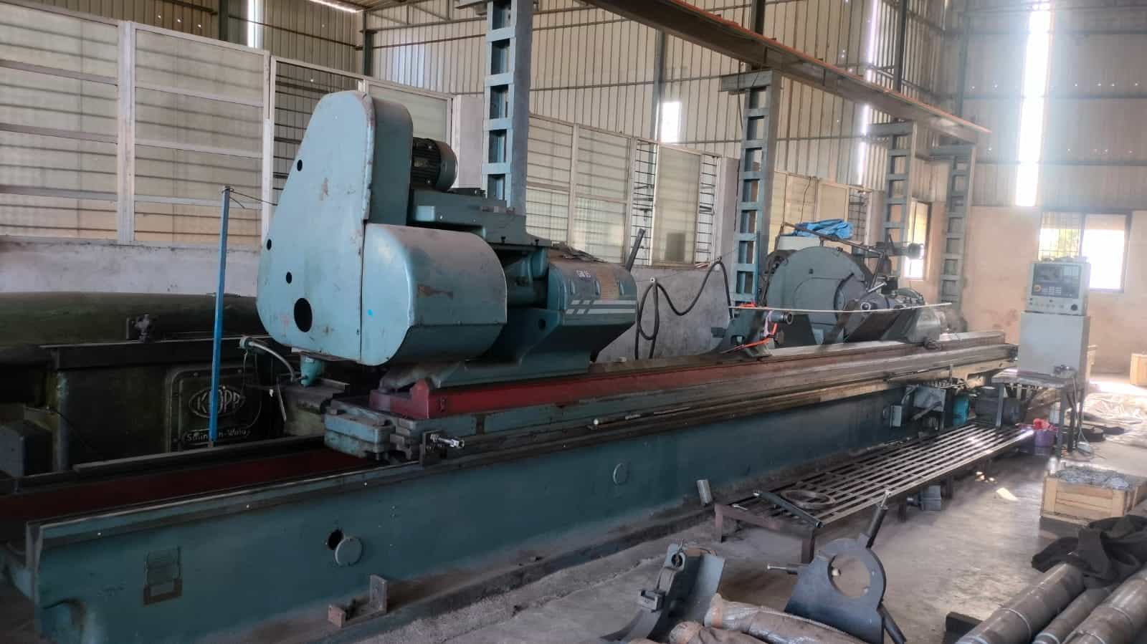
Grinding Machine

Slide 22
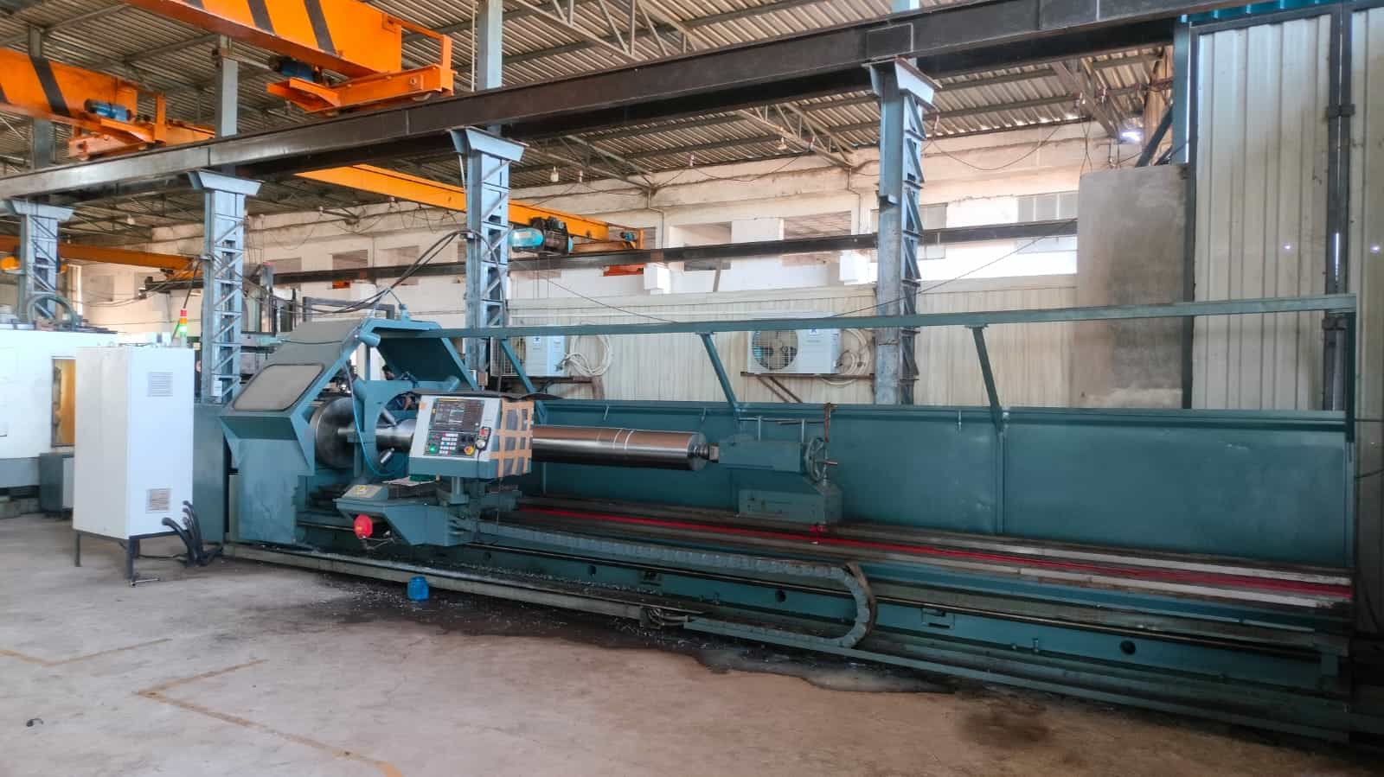
LENGTH :- 10000MM DIAMETER :- 500MM
CNC LATHE

Slide 23










CLIENTS

Slide 24












CLIENTS

Slide 25

WORLD WIDE EXPORTING COUNTRIES
Canada
Netherland
Germany
France
Itely
Korea
Switzerland
Japan
America
UAE
Saudi Arabia
Oman

Slide 26
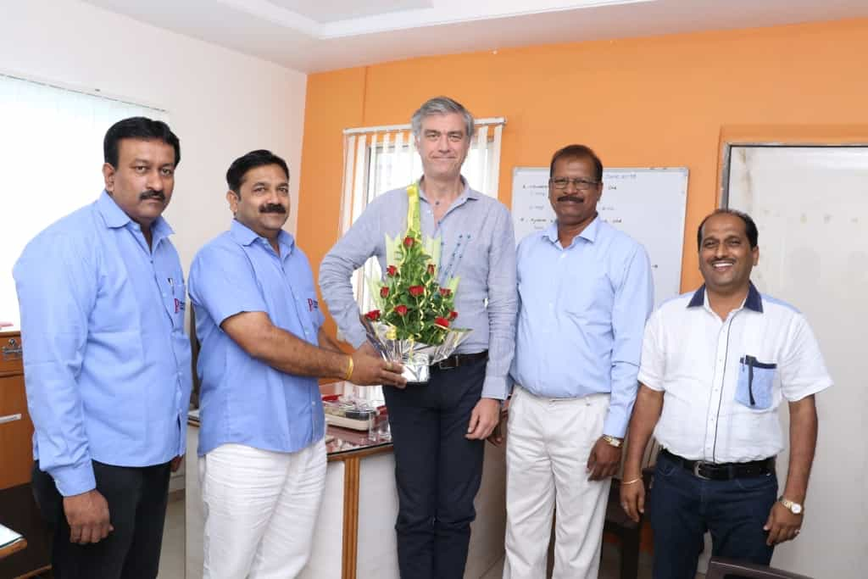
Flowserve Corporation
Mr. Fabrizio Baccani
(Director Manufacturing Flowserve Corporation)
Mr. Jayakumar Jagadeeshan
(Supply Chain Flowserve Corporation)

Slide 27
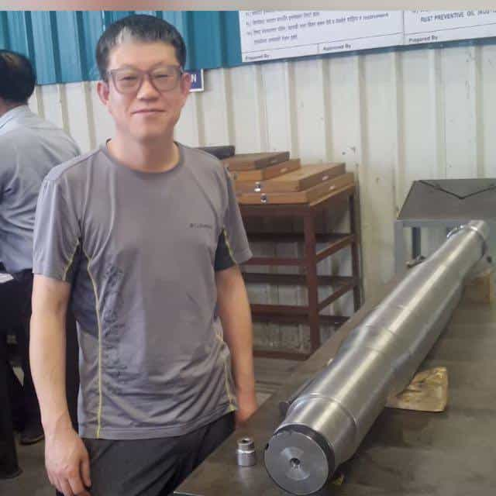
NASH TEAM
Korean Quality Expert Visited
For Inspection

Slide 28
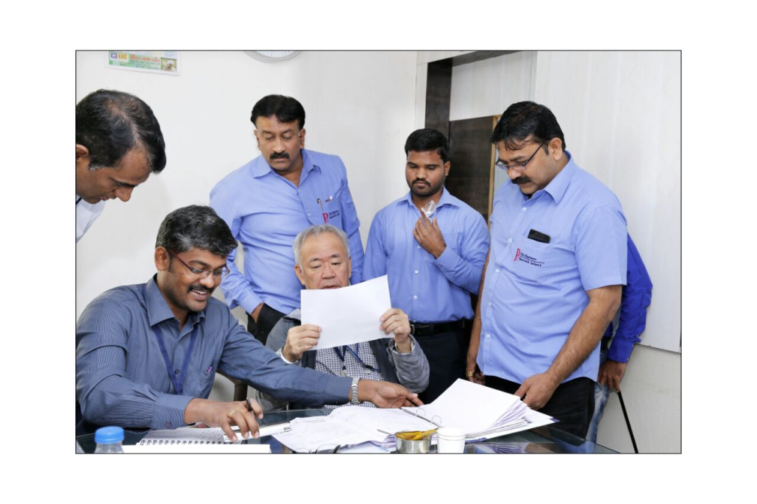
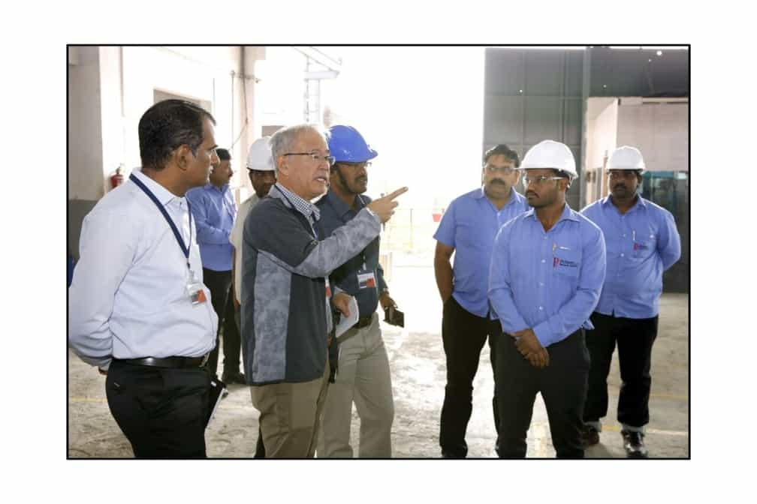
TMEIC TEAM
MR. KATSUKI MANABU –( JAPANESE EXPERT)
MR. BALASUBRAMANIAM – (MANAGER MANUFACTURING ENINEERING)
MR. ANESH PANDIT – (MANAGER VENDOR DEVELOPMENT)
MR. SAILES H PURANIK – (HEAD –SCM & PROCUREMENT)

Slide 29
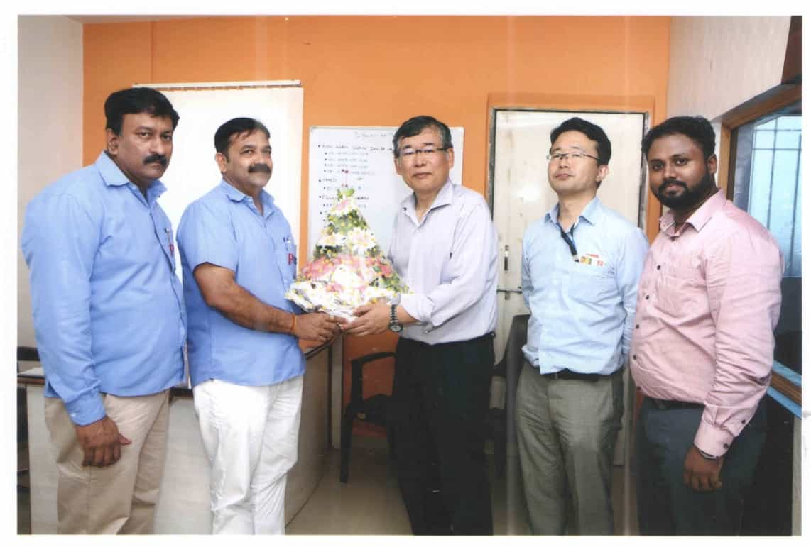
EBARA MACHINERY INDIA PRIVATE LIMITED
Mr. Hiroshi Suzuki
(Director)
Mr. Yusuke Chikamori
(Procurement)
Mr. Rajamanikandan K
(Deputy Manager - Procurement)

Slide 30
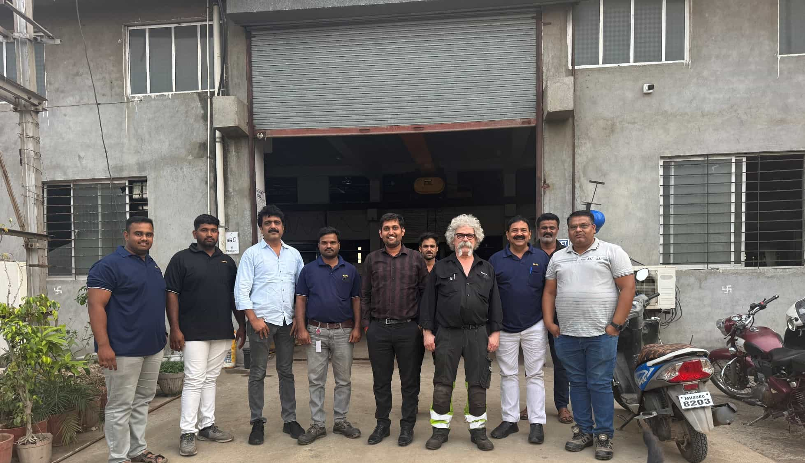
Valmet, Sweden

Slide 31
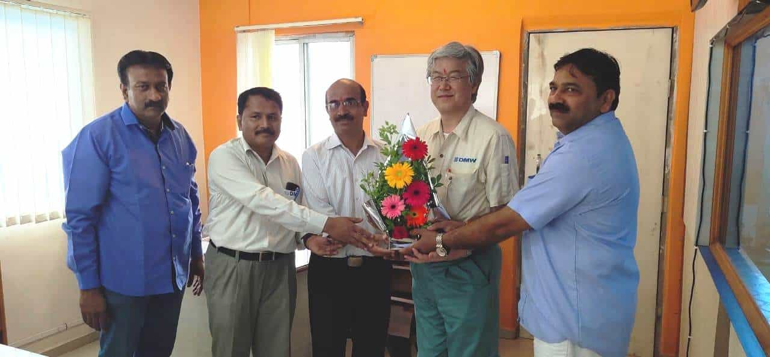
DMW Corporation Ltd.
Mr. Taizo Kobayashi (DMW Japan – Costing Sales)
Mr. Ashok Yadav
(DMW Pune – Factory Manager)
Mr. Gajanan Lokhande
(DMW Pune – QA Manager)

Slide 32
THANK YOU

